Slide 1
School 9 Virtual Open House Pre-K through 6th Grade
Dr. Yazurlo, Principal

Slide 2
Our Home
Virtual Tour
Our School Website is updated frequently
Daily Communication via Phone and Email
Letters Bimonthly
School Spirit Activities
Aides & Teachers with 10+ years in the School
Small School with Lots of Love

Slide 3
Specials
Art
Physical Education
Computers
Coding

Slide 4
Focus on Literacy & Writing
Use of Benchmark Curriculum
Writing Theme of the Month – Showcasing different students and different abilities

Slide 5
Math & Science
Mystery Science Curriculum
Eureka Math and NYS Modules

Slide 6
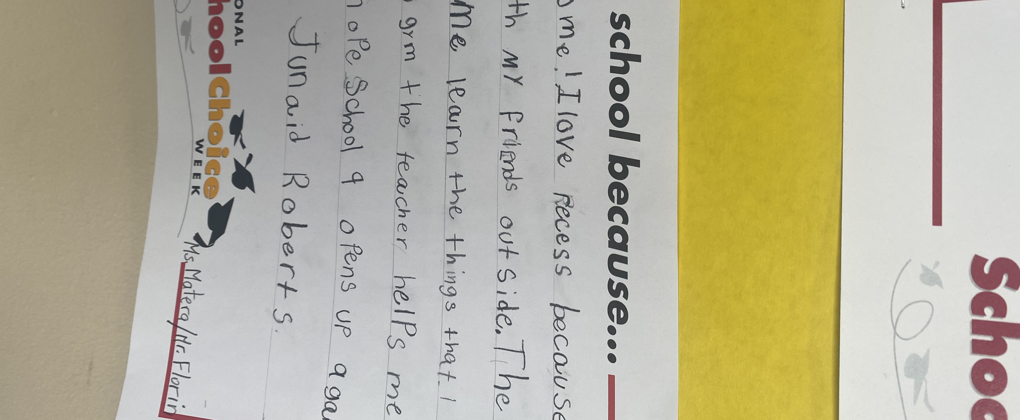
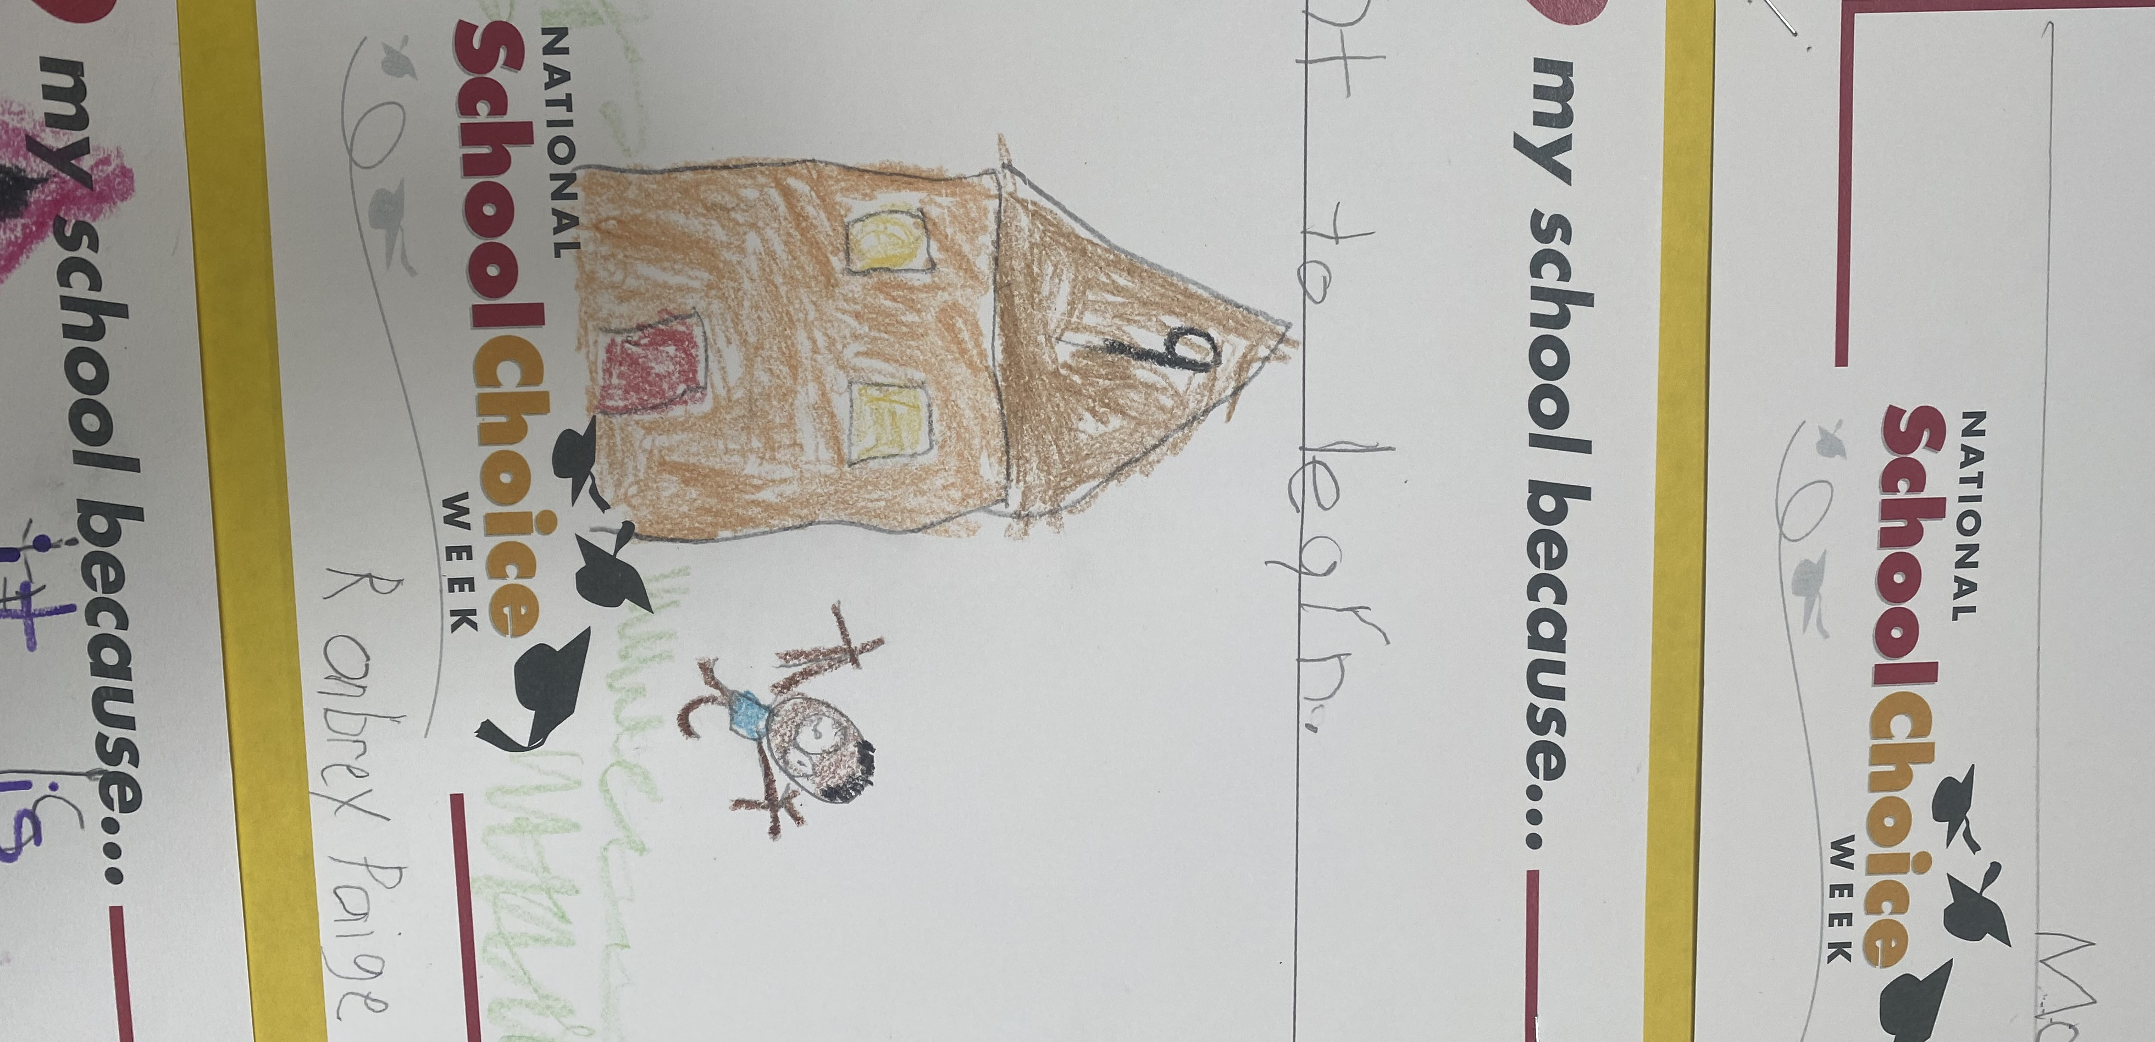
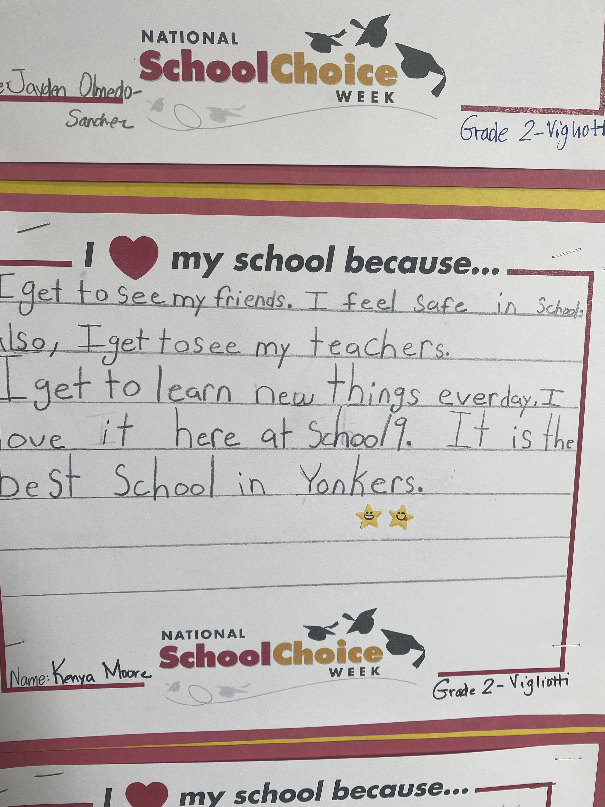
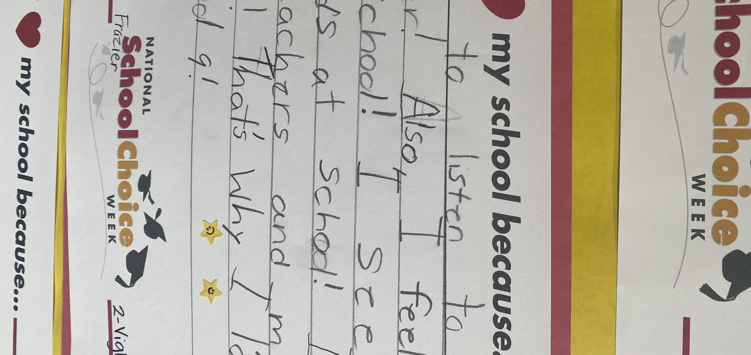
From Our Students

Slide 7
THANK YOU!
Check out our School Website & Follow us on Twitter and Instagram @YPSCHOOL 9

